Slide 1
Chapter 7. Basic Processing Unit

Slide 2
Overview
Instruction Set Processor (ISP):unit which executes machine instructions and co-ordinates the activities of others.
Central Processing Unit (CPU)
A typical computing task consists of a series of steps specified by a sequence of machine instructions that constitute a program.
An instruction is executed by carrying out a sequence of more rudimentary operations.

Slide 3
Some Fundamental Concepts

Slide 4
Fundamental Concepts
To execute a program, the Processor fetches one instruction at a time and perform the operation specified.
Instructions are fetched from successive memory locations until a branch or a jump instruction is encountered.
Processor keeps track of the address of the memory location containing the next instruction to be fetched using Program Counter (PC).
Instruction Register (IR)

Slide 5
Executing an Instruction
Each instructions comprises 4 bytes, and that it is stored in one memory word.
To execute an instruction, the processor perform following 3 steps:
Fetch the contents of the memory location pointed to by the PC. The contents of this location are loaded into the IR (fetch phase).
IR ← [[PC]]
Assuming that the memory is byte addressable, increment the contents of the PC by 4 (fetch phase).
PC ← [PC] + 4
Carry out the actions specified by the instruction in the IR (execution phase).

Slide 6
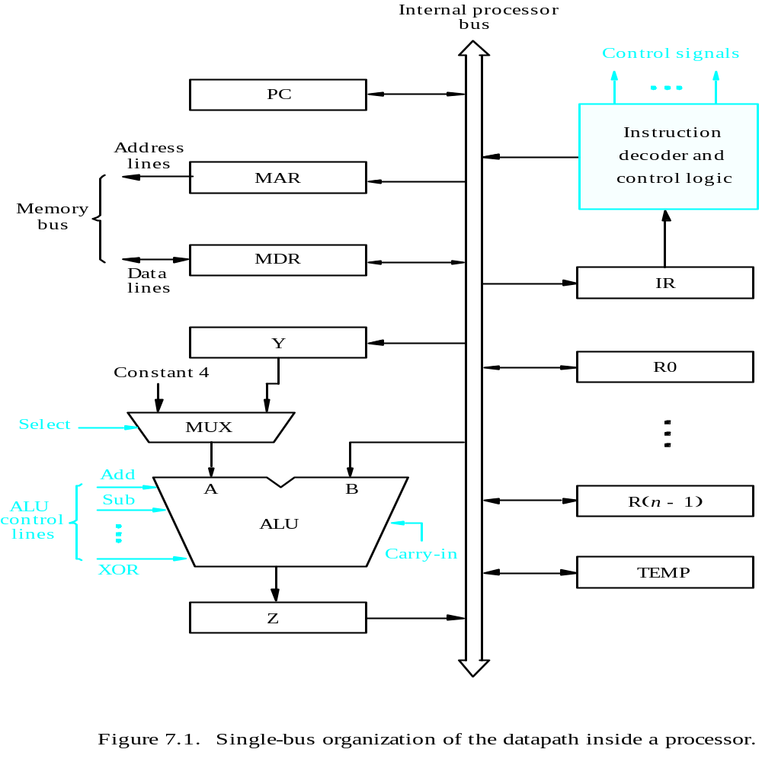
Processor Organization
MDR HAS TWO INPUTS AND TWO OUTPUTS
Datapath
Textbook Page 413

Slide 7
Single Bus Organization
ALU and all the registers are interconnected via a single internal processor bus.
Data and address lines of external memory bus are connected to the internal processor bus via MDR and MAR respectively.
Register MDR has two inputs and two outputs.
Input of MAR is connected to the internal bus, and its output to the external bus.
The control signals(lines) of the memory bus are connected to the instruction decoder and control logic unit.
Instruction decoder and control logic unit issues the signals that control the operation of all units inside the processor and for interacting with the memory bus.

Slide 8
Single Bus Organization cont..
Processor registers R0 through R(n-1) for general purpose use by the programmer and some as special purpose register such as index register or stack pointer.
Three registers, Y,Z, and TEMP are used by the processor for temporary storage during execution of instructions.
The multiplexer MUX selects either the output of register Y or constant 4(to increment the content of PC) to be provided as input A of the ALU.
Select line of MUX can be either select4 or selectY.
The registers, the ALU and the interconnecting bus are collectively referred as datapath.

Slide 9
Executing an Instruction
Transfer a word of data from one processor register to another or to the ALU.
Perform an arithmetic or a logic operation and store the result in a processor register.
Fetch the contents of a given memory location and load them into a processor register.
Store a word of data from a processor register into a given memory location.

Slide 10
Register Transfers
Internal processor
b
us
R
i
in
R
i
R
i
out
Y
in
Y
Constant 4
Select
MUX
A
B
ALU
Z
in
Z
Z
out
Figure 7.2. Input and output gating for the registers in Figure 7.1.

Slide 11
Register transfers
Ex : Transferring data from register R1 to R4. The following actions are needed:
Enable the output of register R1 by making R1_{out} =1.This places the content of R1 on the processor bus.
Enable the input of register R4 by setting R4_{in} =1.This loads the data from internal processor bus into register R4.

Slide 12
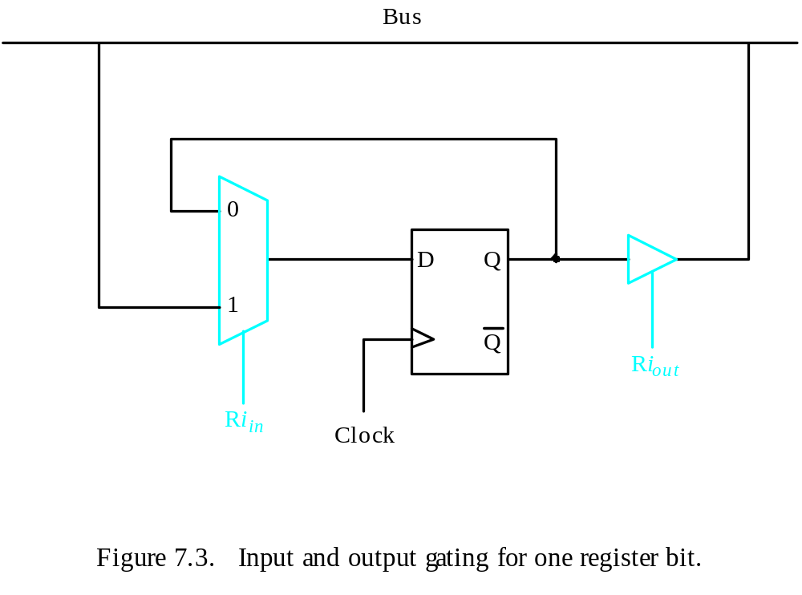
Register Transfers
All operations and data transfers are controlled by the processor clock.
Figure 7.3. Input and output gating for one register bit.

Slide 13
Register Transfers
All operations and data transfers within the processor take place within time periods defined by the processor clock.
Control signals that govern a particular transfer are asserted at the start of the clock cycle.
An implementation for one bit of register Ri is shown in fig.7.3
2-input multiplexer is used to select the data applied to the input of an edge triggered D flip-flop.
When R_{in} =1, the multiplexer selects the data on the bus and loaded into the flip-flop at the raising edge of the clock.
When R_{out}=0, the multiplexer feeds back the value currectly stored in the flip-flop.
Q output of the flip-flop is connected to bus via a tri-state gate.
When Ri_{out}=0, the gate output is in the electrically disconnected state. When Ri_{out}=1, the gate drives the bus to 0 or 1, depending on the value of Q.

Slide 14
Performing an Arithmetic or Logic Operation
The ALU is a combinational circuit that has no internal storage.
ALU gets the two operands from MUX and bus. The result is temporarily stored in register Z.
What is the sequence of operations to add the contents of register R1 to those of R2 and store the result in R3?
  R1_{out}, Y_{in} ; transfer the content of R1 to Y.
  R2_{out}, SelectY, Add, Z_{in} ; R2 contents are transferred to B input of ALU. Numbers are added and stored in Z
  Z_{out}, R3_{in} ; Sum is transferred to register R3.

Slide 15
Performing an Arithmetic or Logic Operation cont..
The signals are activated for the duration of the clock cycles corresponding to that step, with all other signals are deactivated during that time.
In step1: output of R1 and input of Y are enabled, causing the content or R1 to be transferred via a bus to Y register.
Step2 : select Y signal of the MUX is selected, so the contents of the Y is transferred to input A of ALU. Content of R2 are gated onto the bus and to the B input. The Add control signal is set and hence addition is performed. The result is moved into Z since Z_{in} =1.
Step3 : Contents of Z are transferred to destination R3 using Z_{out} and R3_{in} signal. This additional step bcoz only one register output can be enabled during a clock cycle in single bus structure.

Slide 16
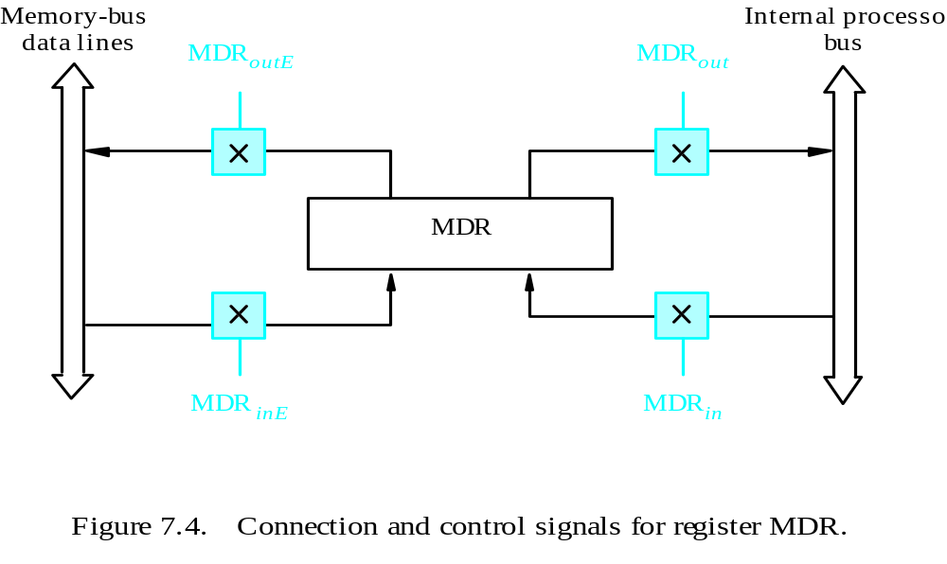
Fetching a Word from Memory
Address into MAR; issue Read operation; data into MDR.
Control the connection to the external bus
Control the connection to the internal bus
Figure 7.4. Connection and control signals for register MDR.

Slide 17
Fetching a Word from Memory
The response time of each memory access varies (cache miss, memory-mapped I/O,…).
To accommodate this, the processor waits until it receives an indication that the requested operation has been completed. Control signal (Memory-Function-Completed, MFC).
Move (R1), R2
MAR ← [R1]
Start a Read operation on the memory bus
Wait for the MFC response from the memory
Load MDR from the memory bus
R2 ← [MDR]
In three steps
R1_{out} , MAR_{in} ,Read
MDR_{inE} ,WMFC
MDR_{out} ,R2_{in}

Slide 18
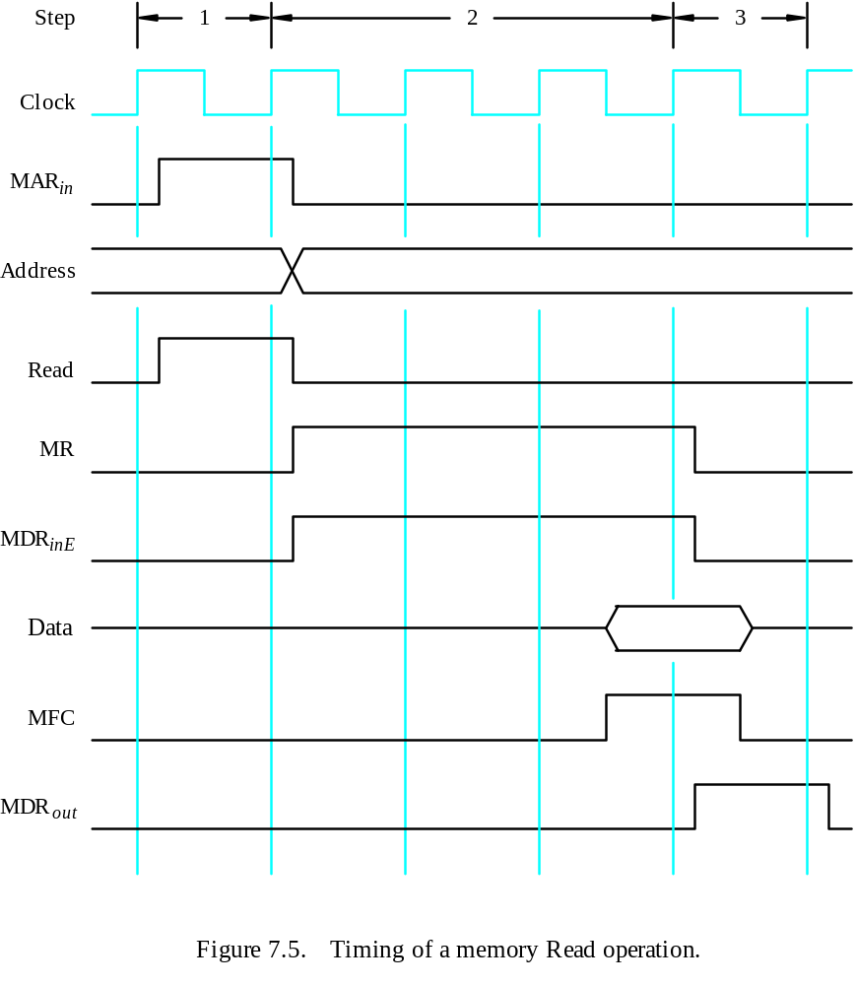
Timing
MAR ← [R1]
Assume MAR
is always available
on the address lines
of the memory bus.
Start a Read operation on the memory bus
Wait for the MFC response from the memory
Load MDR from the memory bus
R2 ← [MDR]

Slide 19
Storing a word in memory
Writing a word into a memory location follows:
The desired address is loaded into MDR.
The data to be written are loaded into MDR
A write command is issued.
Ex: Move R2, (R1)
R1_{out} ,MAR_{in}
R2_{out} ,MDR_{in}, Write
MDR_{out E},WMFC

Slide 20
Execution of a Complete Instruction
Add (R3), R1
Fetch the instruction
Fetch the first operand (the contents of the memory location pointed to by R3)
Perform the addition
Load the result into R1

Slide 21
Architecture
Internal processor
b
us
R
i
in
R
i
R
i
out
Y
in
Y
Constant 4
Select
MUX
A
B
ALU
Z
in
Z
Z
out
Figure 7.2. Input and output gating for the registers in Figure 7.1.

Slide 22
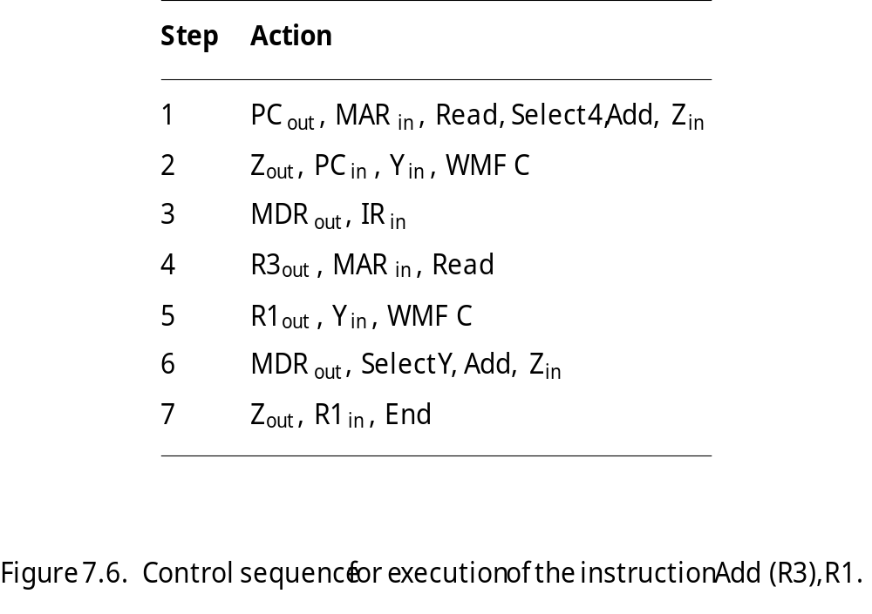
Execution of a Complete Instruction
Add (R3), R1

Slide 23
Execution of Branch Instructions
A branch instruction replaces the contents of PC with the branch target address, which is usually obtained by adding an offset X given in the branch instruction.
The offset X is usually the difference between the branch target address and the address immediately following the branch instruction.
Conditional branch

Slide 24
Execution of Branch Instructions
Step
Action
1
PC
out
,
MAR
in
,
Read,
Select4,
Add,
Z
in
2
Z
out
,
PC
in
,
Y
in
,
WMF
C
3
MDR
out
,
IR
in
4
Offset-field-of-IR
out
,
Add,
Z
in
5
Z
out
,
PC
in
,
End
Figure 7.7. Control sequence for an unconditional branch instruction.

Slide 25
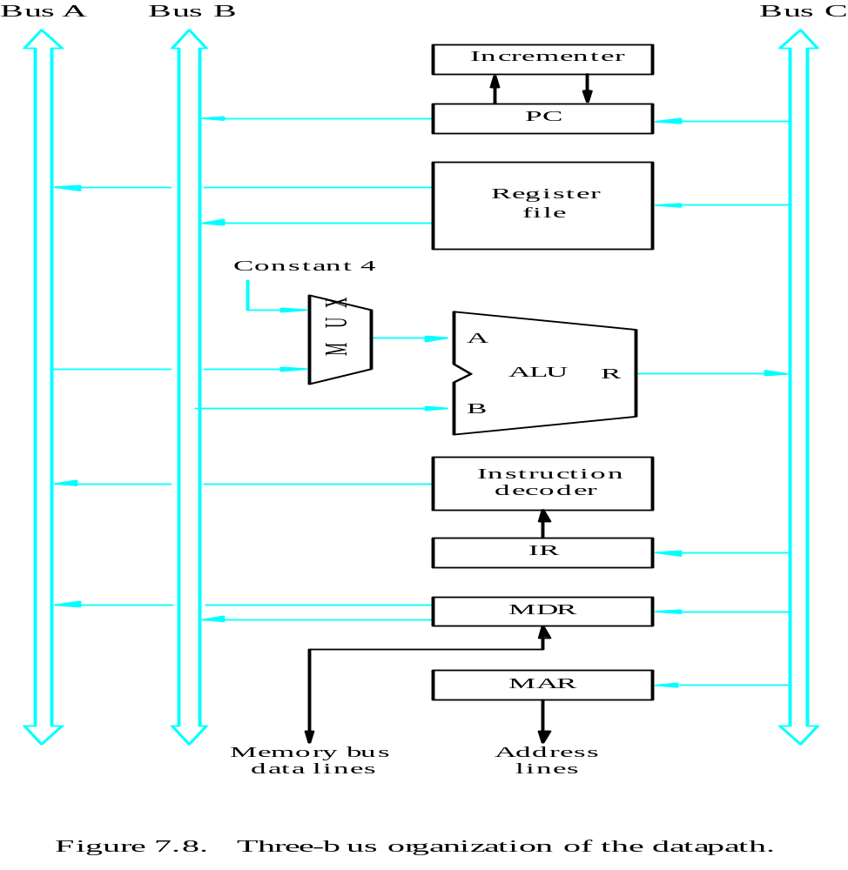
Multiple-Bus Organization

Slide 26
Multiple-Bus Organization
Add R4, R5, R6
Step
Action
1
PC
out
,
R=B,
MAR
in
,
Read,
IncPC
2
WMF
C
3
MDR
outB
,
R=B,
IR
in
4
R4
outA
,
R5
outB
,
SelectA,
Add,
R6
in
,
End
Figure 7.9. Control sequence for the instruction. Add R4,R5,R6,
for the three-bus organization in Figure 7.8.

Slide 27
Quiz
What is the control sequence for execution of the instruction
Add R1, R2
including the instruction fetch phase? (Assume single bus architecture)

Slide 28
Hardwired Control

Slide 29
Overview
To execute instructions, the processor must have some means of generating the control signals needed in the proper sequence.
Two categories: hardwired control and microprogrammed control
Hardwired system can operate at high speed; but with little flexibility.

Slide 30
Control Unit Organization
Clock
CLK
Control step
counter
External
inputs
Decoder/
IR
encoder
Condition
codes
Control signals
Figure 7.10. Control unit organization.

Slide 31
Control Unit Organization cont..
Fig 7.10 shows the organization of the hardwired control unit.
A counter driven by a clock signal CLK, can used to keep track of the control steps.
The required control signals are determined by the following information:
Contents of control step counter
Contents of instruction register
Contents of condition code flags
External input signal, such as MFC, and interrupt requests.
The decoder/encoder block is a combinational circuit that generates required control outputs, depending on the state of all inputs.

Slide 32
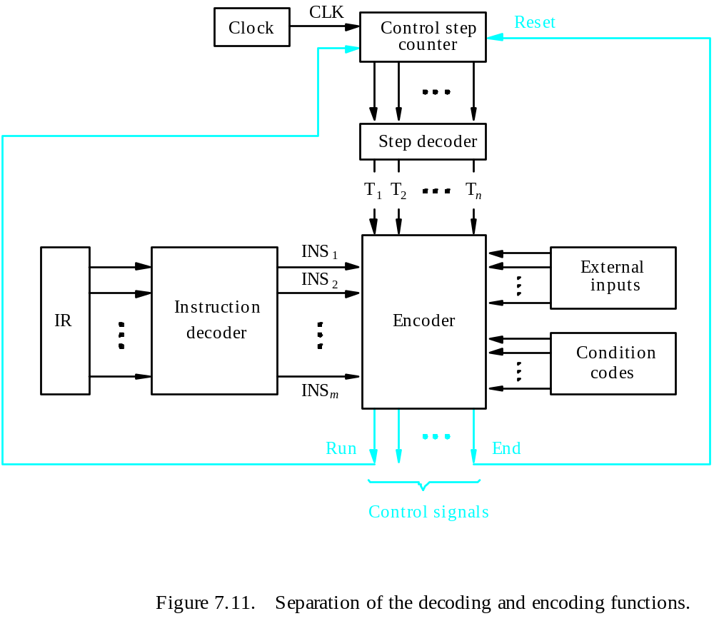
Detailed Block Description

Slide 33
Detailed Block Description
Fig 7.11. separation of the decoding and encoding functions detailed block diagram.
The step decoder provides a separate signal line for each step in the control sequence.
The output of the instruction decoder consists of a separate line for each machine instruction.
For any instruction loaded in IR, one of the output lines INS₁ through INS_{m} is set to 1 and all other lines are set to 0.
The input signals to the encoder block are combined to generate individual control signals Z_{in}, Add, P_{cout} and so on

Slide 34
Generating Z_{in}
Z_{in} = T₁ + T₆ • ADD + T₄ • BR + …
Branch
Add
T
4
T
6
T
1
Figure 7.12. Generation of the Z_{in} control signal for the processor in Figure 7.1.

Slide 35
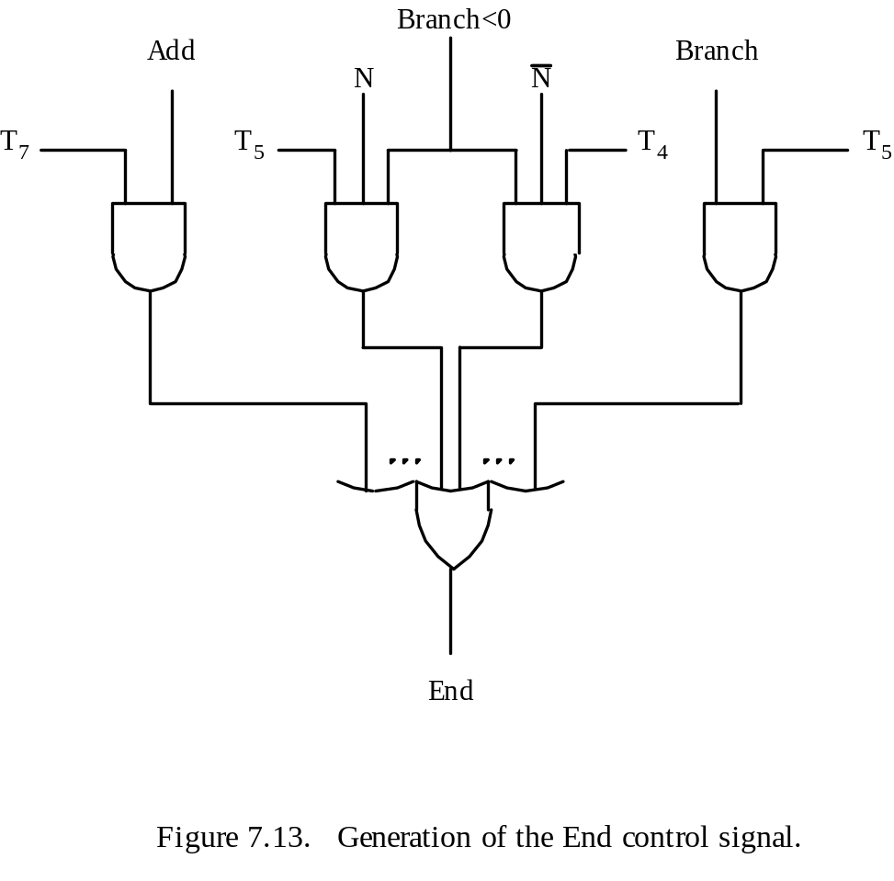
Generating End
End = T₇ • ADD + T₅ • BR + (T₅ • N + T₄ • N) • BRN +…

Slide 36
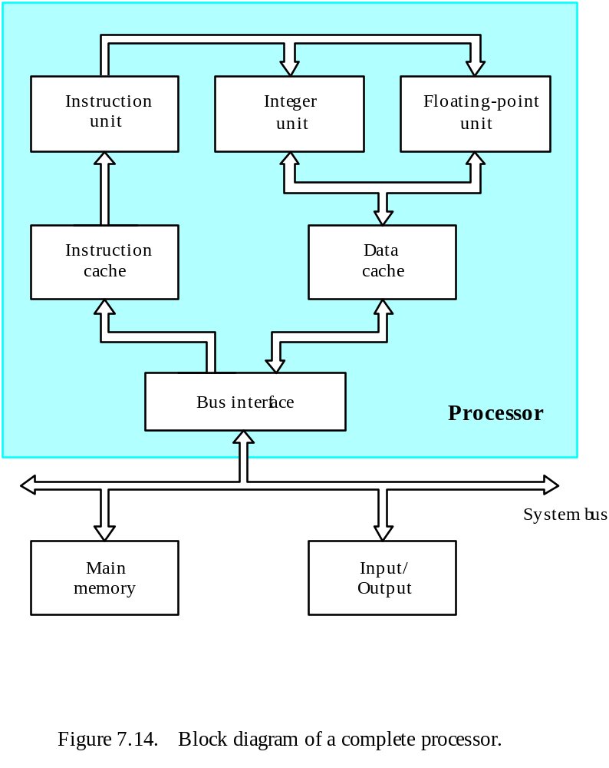
A Complete Processor

Slide 37
Chapter 8. Pipelining

Slide 38
Overview
Pipelining is widely used in modern processors.
Pipelining improves system performance in terms of throughput.
Pipelined organization requires sophisticated compilation techniques.

Slide 39
Basic Concepts

Slide 40
Making the Execution of Programs Faster
Use faster circuit technology to build the processor and the main memory.
Arrange the hardware so that more than one operation can be performed at the same time.
In the latter way, the number of operations performed per second is increased even though the elapsed time needed to perform any one operation is not changed.

Slide 41
Traditional Pipeline Concept
Laundry Example
Ann, Brian, Cathy, Dave
each have one load of clothes
to wash, dry, and fold
Washer takes 30 minutes
Dryer takes 40 minutes
“Folder” takes 20 minutes
A
B
C
D

Slide 42
Traditional Pipeline Concept
6 PM
7
8
9
10
11
Midnight
Time
30
40
20
30
40
20
30
40
20
30
40
20
Sequential laundry takes 6 hours for 4 loads
If they learned pipelining, how long would laundry take?
A
B
C
D

Slide 43
Traditional Pipeline Concept
6 PM
7
8
9
10
11
Midnight
T
a
s
k
O
r
d
e
r
Time
30
40
40
40
40
20
A
Pipelined laundry takes 3.5 hours for 4 loads
B
C
D

Slide 44
Traditional Pipeline Concept
6 PM
7
8
9
Pipelining doesn’t help latency of single task, it helps throughput of entire workload
Pipeline rate limited by slowest pipeline stage
Multiple tasks operating simultaneously using different resources
Potential speedup = Number pipe stages
Unbalanced lengths of pipe stages reduces speedup
Time to “fill” pipeline and time to “drain” it reduces speedup
Stall for Dependences
Time
T
a
s
k
O
r
d
e
r
30
40
40
40
40
20
A
B
C
D

Slide 45
Use the Idea of Pipelining in a Computer
Fetch + Execution
T
ime
I
1
I
2
I
3
T
ime
Clock cycle
1
2
3
4
F
1
E
1
F
2
E
2
F
3
E
3
Instruction
(a) Sequential execution
I
1
F
1
E
1
I
2
F
2
E
2
Interstage buffer
B1
I
3
F
3
E
3
Instruction
Ex
ecution
fetch
unit
(c) Pipelined execution
unit
(b) Hardware organization
Figure 8.1. Basic idea of instruction pipelining.

Slide 46
Basic idea of instruction pipelining.
The computer i.e., the processor executes a program by fetching and executing instruction(stored in memory) sequentially, one by one.
Let F_{j} = fetch and E_{j} =execute steps for instruction I_{j} in fig 8.1(a).
The execution of program consists of sequence of fetch and execute phases. This is called sequential execution, where operations are performed one after the other.
To achieve high performance: operations are performed in an overlapped fashion.
Assume that computer has two separate hardware units for fetching and executing as in fig.8.1(b).
Buffer stores the present instruction while the fetch unit is getting the next instruction. This allows the two operations to be executed independent of each other. Hence, problem with sequential execution is eliminated.

Slide 47
Basic idea of instruction pipelining.
In first clock cycle, the fetch unit fetches instruction I₁ (step F₁) and stores it in the buffer B₁.
In second clock cycle, the fetch unit proceeds with fetch for instruction I₂ (step F₁). In the same interval, the execution unit performed the operation specified by instruction I₁ ,using the content of buffer B(step E₁).by the end of clock cycle 2, instruction I₁ is completed and instruction I₂ is fetched.
Continuing with the process, by the end of clock cycle 4, all 3 instructions are completed.
The above method is a two stage pipelining.

Slide 48
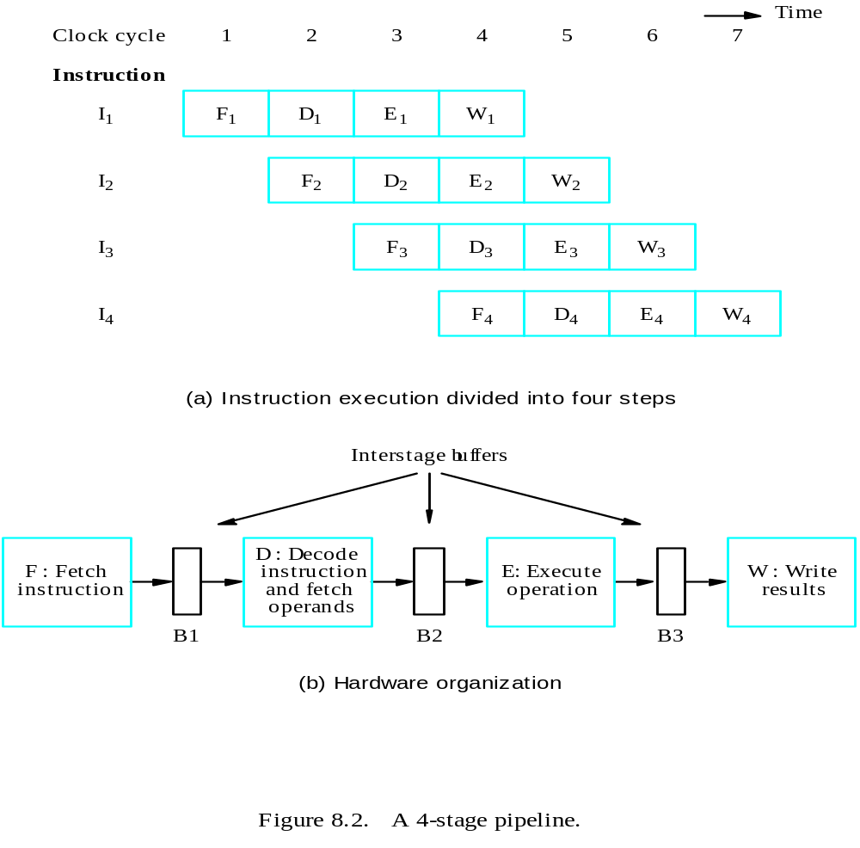
4 stage Pipeline in a Computer
Fetch + Decode
+ Execution + Write
Textbook page: 457

Slide 49
4 stage pipeline
The processing of an instruction need not be divided into only 2 steps
Completion rate of instructions can be improved by increasing the number of stages in the pipeline.
In fig 8.1(a), the instruction execution is divided into 4 steps.
F Fetch: read the instruction from memory
D Decode: decode the instruction and fetch the source operand.
E Execute: perform the operation specified by the instruction.
W Write: store the result in the destination location.
This necessitates 4 hardware unit and it allows 4 instructions to be in progress at any given time. Information is passed from one unit to the next through a storage buffer.
The units must be capable of handling their tasks simultaneously and without interfering with one another.

Slide 50
Role of Cache Memory
Each pipeline stage is expected to complete in one clock cycle.
The clock period should be long enough to let the slowest pipeline stage to complete.
Faster stages can only wait for the slowest one to complete.
Since main memory is very slow compared to the execution, if each instruction needs to be fetched from main memory, pipeline is almost useless.
Fortunately, we have cache.

Slide 51
Pipeline Performance
The potential increase in performance resulting from pipelining is proportional to the number of pipeline stages.
However, this increase would be achieved only if all pipeline stages require the same time to complete, and there is no interruption throughout program execution.
Unfortunately, this is not true.

Slide 52
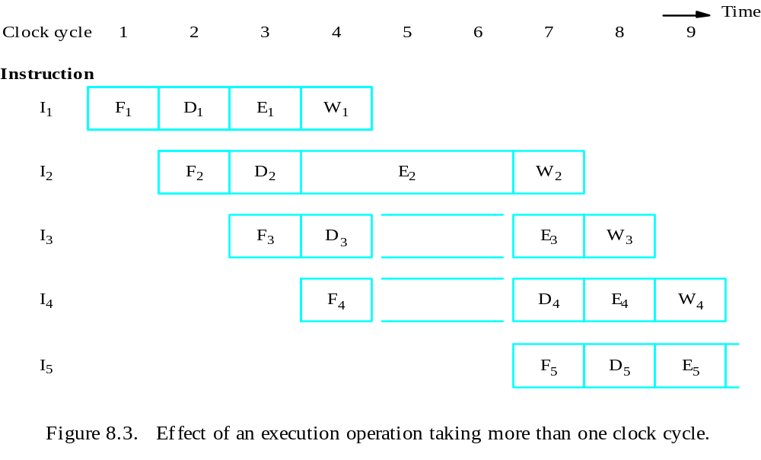
Pipeline Performance

Slide 53
Pipeline Performance
The previous pipeline is said to have been stalled for two clock cycles.
Any condition that causes a pipeline to stall is called a hazard.
Data hazard – any condition in which either the source or the destination operands of an instruction are not available at the time expected in the pipeline. So some operation has to be delayed, and the pipeline stalls.
Instruction (control) hazard – a delay in the availability of an instruction causes the pipeline to stall.
Structural hazard – the situation when two instructions require the use of a given hardware resource at the same time.

Slide 54
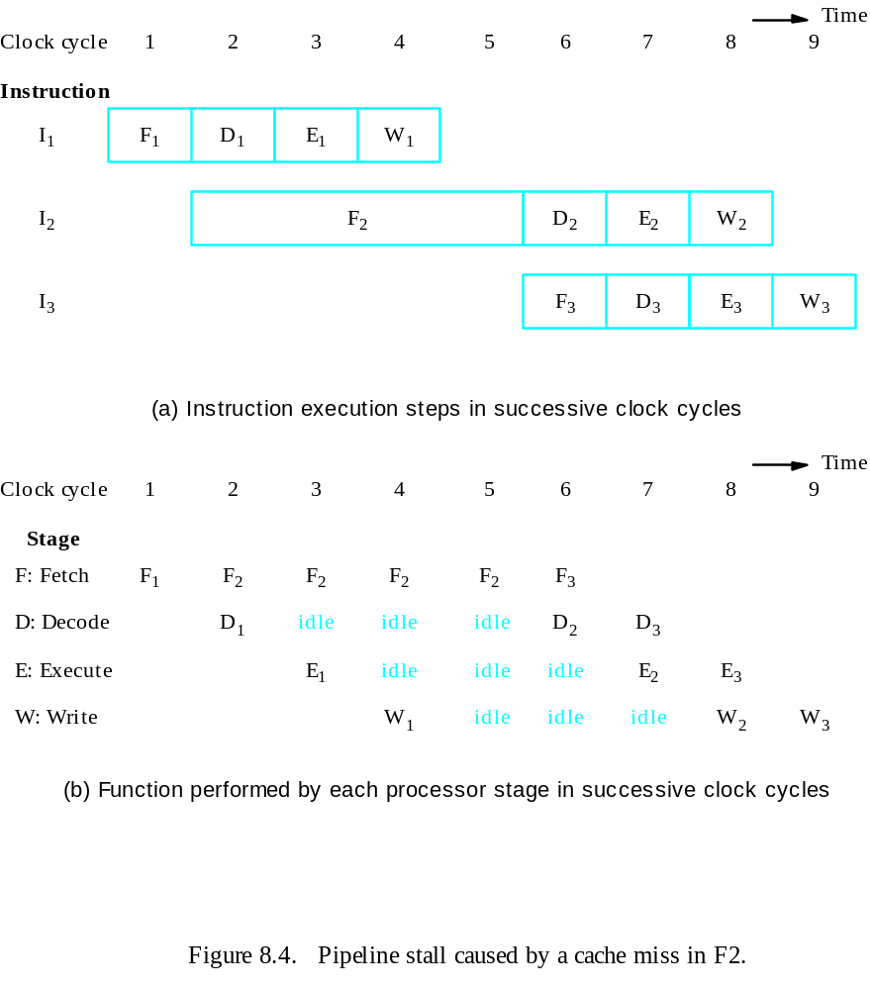
Pipeline Performance
Instruction hazard
Idle periods – stalls (bubbles)

Slide 55
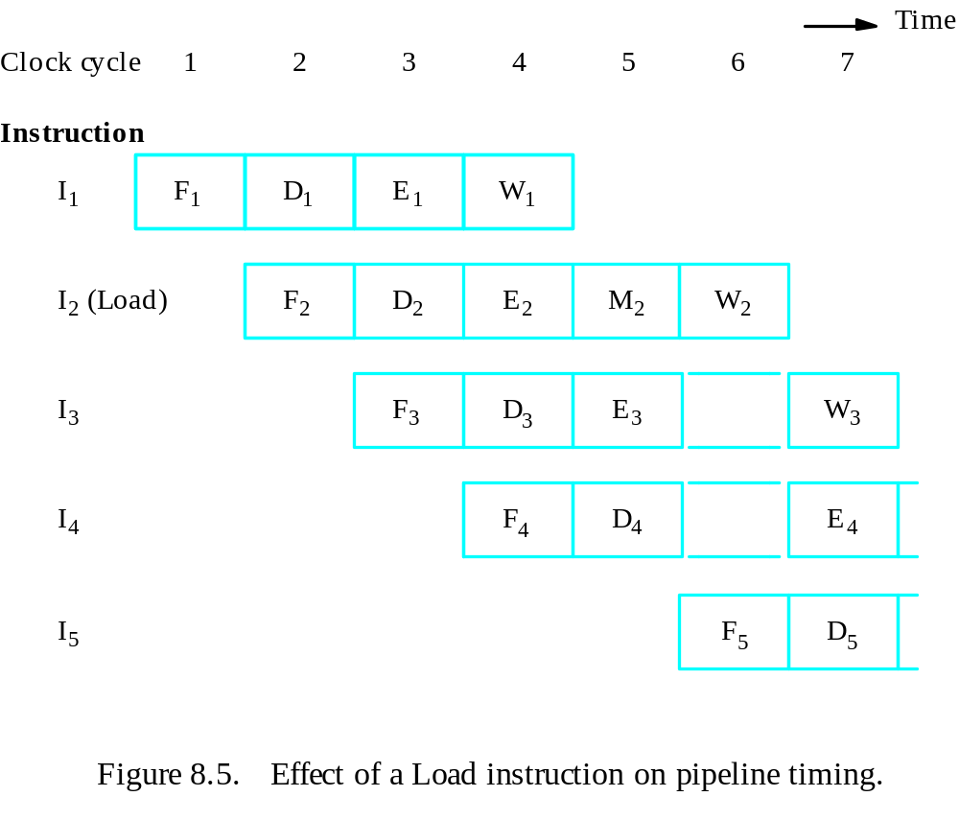
Pipeline Performance
Structural hazard
Load X(R1), R2

Slide 56
Pipeline Performance
Again, pipelining does not result in individual instructions being executed faster; rather, it is the throughput that increases.
Throughput is measured by the rate at which instruction execution is completed.
Pipeline stall causes degradation in pipeline performance.
We need to identify all hazards that may cause the pipeline to stall and to find ways to minimize their impact.

Slide 57
Quiz
Four instructions, the I2 takes two clock cycles for execution. Pls draw the figure for 4-stage pipeline, and figure out the total cycles needed for the four instructions to complete.

